Slide 1
أكـــــاديميــــة طــــويـــق
Artificial Intelligence Ethics

Slide 2
AI Accountability & Transparency
By: Dr. Afshan Hashmi

Slide 3
Course Objectives:
Understand the importance of AI accountability and transparency.
Explore explainability tools and governance mechanisms.
Learn about real-world case studies.
Identify future directions and challenges.

Slide 4

Foundations of AI Accountability
AI accountability refers to the mechanisms and principles that ensure individuals or organizations are answerable for AI systems' behavior and outcomes.
Core Concepts
Accountability: Traceability of AI decisions to responsible entities
Transparency: Visibility into AI system operations and decision logic
Explainability: Ability to interpret and justify AI outputs
Why It Matters
Prevents harm from biased/algorithms
Builds trust with users and regulators
Ensures compliance with evolving regulations (GDPR, EU AI Act)

Slide 5
Key Stakeholders
Stakeholder | Concerns
Developers | Model fairness, technical debt
Businesses | Legal risk, brand reputation
Regulators | Compliance, public safety
End Users | Privacy, fair treatment

Slide 6
Explainability in AI Governance
Explainability ensures that AI models are transparent and understandable not only for developers, but also for stakeholders, regulators, and end-users.
It plays a critical role in AI governance, which is about making sure AI systems are ethical, fair, and accountable.
Technical Approaches to Explainability
There are two main levels of explainability:
1. Global Explanations
Goal: Understand the overall behavior of a model.
Examples:
Feature importance: Which features influence the model the most?
Decision rules: If using decision trees or rule-based systems.
Use case: For developers, auditors, and data scientists to evaluate the model as a whole.

Slide 7
Explainability in AI Governance
2. Local Explanations
Goal: Explain why a specific prediction was made.
Common methods:
LIME (Local Interpretable Model-Agnostic Explanations): Builds a simple model around a single prediction to explain it.
SHAP (SHapley Additive exPlanations): Uses game theory to assign importance to each feature in a prediction.
Counterfactuals: Show how a prediction would change if input features were different.
Use case: For explaining individual decisions to users, e.g., why a loan was denied.

Slide 8
Implementation Checklist
When implementing explainable AI in practice, consider:
1. Document Model Purpose and Limitations
What is the model used for?
What are its known biases or limitations?
2. Choose Appropriate XAI Methods Based On:
Model complexity:
Simple models (e.g., decision trees) may not need SHAP/LIME.
Complex models (e.g., neural networks) often do.
Stakeholder needs:Data scientists vs business leaders vs customers.
Regulatory requirements:Some sectors (like finance or healthcare) require explanations by law.
3. Establish Explanation Protocols
Design different explanations for:
Technical users: detailed insights.
Non-technical users: simple summaries.
Regulators: documentation and audit trails.

Slide 9
Explainability in AI Governance
Aspect | Description
Global Explanation | Understand overall model behavior
Local Explanation | Justify individual predictions
OECD & IEEE | Governance frameworks pushing for transparency
Checklist | Align explanation methods with users, models, and legal needs

Slide 10
Tools for AI Transparency
These are specialized toolkits and platforms that help make AI models more transparent, fair, and explainable.
Transparency tools help users understand:
How a model works
Why it made a certain prediction
Whether it treats different groups fairly
Toolkits and Platforms
Here are some commonly used tools:
1. IBM AI Explainability 360 (AIX360)
Open-source library by IBM.
Provides algorithms to explain ML models.
Supports both global and local explainability.
Example: Use AIX360 to understand which features most influence a loan approval model.

Slide 11
Tools for AI Transparency
2. Google What-If Tool
Interactive tool within TensorBoard.
Allows users to:
Test model predictions by changing inputs.
Explore counterfactuals (What happens if this input changes?).
Visualize decision boundaries.
Great for debugging and understanding models without writing code.
3. Microsoft InterpretML
Library for model interpretability.
Offers techniques like:
SHAP
LIME
GlassBox models (interpretable models by design like Explainable Boosting Machines)
Can be used with many scikit-learn-compatible models.

Slide 12
Tools for AI Transparency
4. Fairlearn & AIF360
Fairlearn (by Microsoft): Focuses on fairness metrics and mitigation.
AIF360 (by IBM): Helps identify and mitigate bias in datasets and models.
Example: Check if your model treats male and female users equally.
5. Model Cards & Datasheets
Model cards: Summarize details about an AI model:
Intended use
Performance
Ethical considerations
Datasheets: Similar concept for datasets—explains where the data came from, its limitations, biases, etc.
Helps ensure responsible sharing and usage of models and data.

Slide 13
Functionality of These Tools
Feature | What It Does
Model Behavior Visualization | Shows how inputs relate to outputs
Bias Detection | Highlights unequal treatment across different groups
Fairness Auditing | Measures fairness metrics (e.g., demographic parity)
Prediction Explanation | Explains why a specific decision was made by the model
Why Use These Tools?
Build trust with users and stakeholders.
Meet regulatory requirements (especially in sensitive sectors).
Help debug, improve, and document your models responsibly.

Slide 14
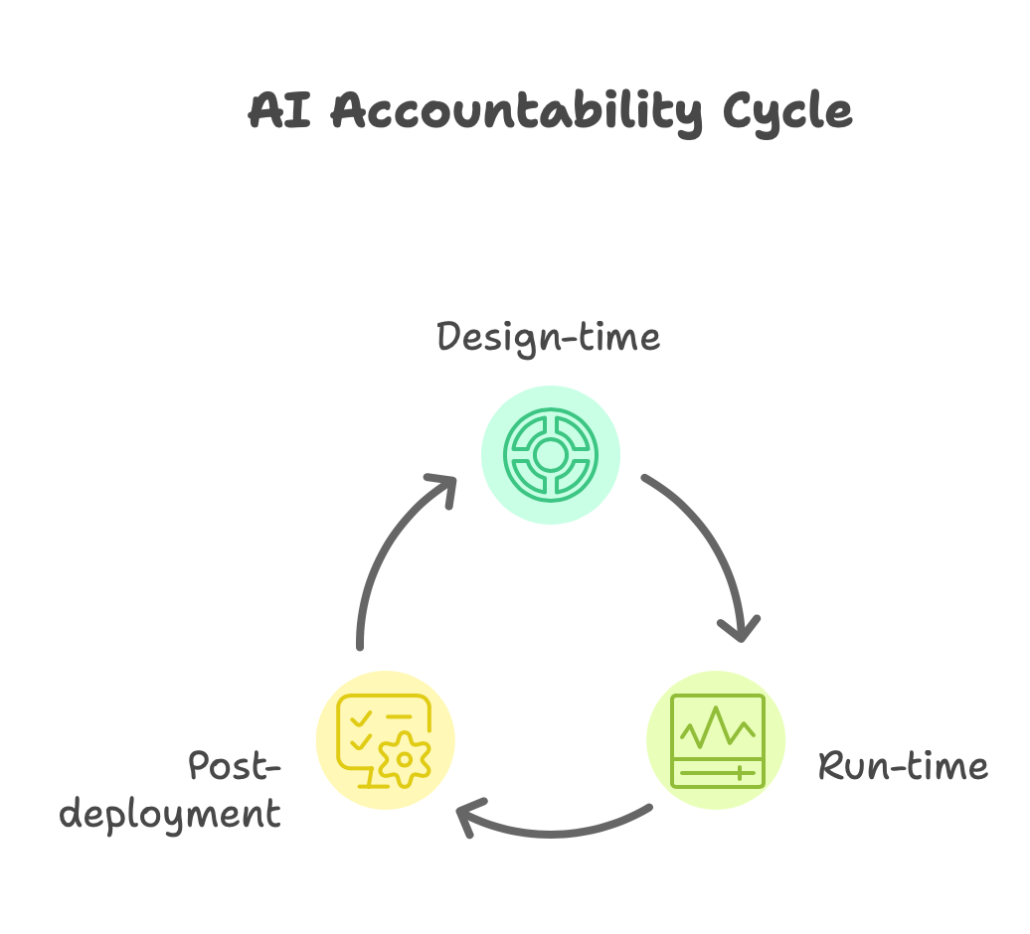
Accountability Mechanisms in AI
Goal: Ensure that AI systems are responsible, ethical, and can be held accountable for their outcomes.
To achieve this, organizations use mechanisms at three key stages:
Design-time (Before deployment)
Run-time (During operation)
Post-deployment (After release)

Slide 15
Accountability Mechanisms in AI
1. Design-time Mechanisms
These are practices used during the development phase to build responsibility into the system from the start.
Examples:
Documentation (Data Sheets, Model Cards)
Clearly explain:
What the model does
Who it’s for
Its limitations, biases, and performance
Helps reviewers and stakeholders understand the system.
Ethical Risk Assessments
Identify possible ethical issues or harms (e.g., discrimination, surveillance, manipulation) before they happen.
Evaluate the societal and legal risks of using the AI system.
Inclusive Design Processes
Involve diverse voices (ethnicities, genders, abilities, communities) in model design to reduce bias and improve fairness.

Slide 16
Accountability Mechanisms in AI
2. Run-time Mechanisms
These are real-time tools and processes that monitor and manage the AI system while it's running.
Examples:
Logging and Audit Trails
Record what the model did, when, and why.
Critical for tracing back decisions if something goes wrong.
Human-in-the-Loop Oversight
Keep a human supervisor in the process for sensitive or high-impact decisions (e.g., medical diagnoses, loan approvals).
Allows humans to override or verify AI decisions.
Performance Monitoring and Anomaly Detection
Keep track of accuracy, fairness, drift, and unexpected behaviors.
Alerts when performance drops or data changes significantly.

Slide 17
Accountability Mechanisms in AI
3. Post-deployment Mechanisms
These are actions taken after the AI system is live to ensure continuous accountability.
Examples:
Redressal Mechanisms
Allow users to challenge, report, or appeal decisions (e.g., if an AI system wrongly rejects a loan).
Ensures the system can be corrected or explained.
Feedback Loops
Collect user feedback and use it to refine the system.
Helps adapt to real-world usage and changing needs.
Continuous Improvement and Retraining
Regularly retrain the model with updated data to maintain fairness and performance.
Avoids issues like data drift and outdated behavior.

Slide 18
Accountability Mechanisms in AI- summary
Stage | Mechanism | Purpose
Design-time | Data sheets, ethical assessments | Build responsible AI from the start
Run-time | Logging, human oversight, monitoring | Keep AI behavior safe during operation
Post-deployment | Redressal, feedback, retraining | Ensure long-term accountability & trust

Slide 19
Implementation Frameworks
These are guidelines, policies, and legal standards that organizations and governments use to ensure that AI systems are ethical, fair, transparent, and accountable.
They help answer:
How do we build AI responsibly?
How do we govern it during use?
How do we respond when things go wrong?
Framework Examples
1. OECD AI Principles
Developed by the Organisation for Economic Co-operation and Development.
Focuses on:
Inclusive growth
Human-centered values
Transparency & accountability
Robustness & security
International cooperation
These principles are adopted by 40+ countries and form a foundation for responsible AI development.

Slide 20
Implementation Frameworks
2. EU AI Act (2024)
A landmark regulation by the European Union.
Classifies AI systems by risk level (unacceptable, high, limited, minimal).
Imposes strict requirements for high-risk AI:
Transparency
Risk assessments
Human oversight
Documentation and logging
First major legal framework in the world to regulate AI directly.
3. NIST AI Risk Management Framework
Created by the U.S. National Institute of Standards and Technology.
Helps organizations identify, assess, manage, and monitor AI risks.
Based on principles like:
Fairness
Explainability
Privacy
Trustworthiness
It’s voluntary but widely adopted by enterprises and governments to build responsible AI systems.

Slide 21
Enterprise Adoption Strategies
Here’s how companies can put these frameworks into practice:
Integrate Accountability into ML Lifecycle
Embed ethical checks and documentation at each stage:
Data collection
Model training
Deployment
Monitoring
Helps ensure traceability and ethical decision-making throughout the pipeline.
Create Internal Ethics Review Boards
Teams made of:
AI researchers
Policy experts
Legal and ethical advisors
Review sensitive projects before they launch.
Ensures AI is aligned with company values and legal regulations.

Slide 22
Enterprise Adoption Strategies
Conduct Impact Assessments
Evaluate how AI systems affect:
People's rights and freedoms
Marginalized communities
Business risks
Tools like Algorithmic Impact Assessments (AIAs) are used.
Helps prevent harm and build public trust.
Element | Purpose
OECD AI Principles | Promote responsible AI globally
EU AI Act | Legally regulate high-risk AI in the EU
NIST Framework | Manage risks in AI systems in the U.S.
Enterprise Best Practices | Operationalize frameworks through ethics boards & assessments

Slide 23
Challenges & Future Directions in AI Governance
Current Issues
These are the major obstacles faced today when building ethical, trustworthy, and explainable AI systems:
1. Trade-off Between Accuracy and Interpretability
Problem: Highly accurate models (like deep neural networks) are often complex and hard to explain.
Example: A deep learning model might diagnose diseases better than a human but can't easily explain why it made a certain decision.
Challenge: How do we balance the need for performance with the need for transparency and user trust?
2. Proprietary Algorithms and Black-Box Models
Many AI systems are built by private companies using closed-source or black-box algorithms.
Users and even regulators often don’t know how the model works or what data it uses. Concern: Lack of transparency can lead to unfair, biased, or unaccountable decision-making (e.g., in hiring, credit, or justice systems).

Slide 24
Challenges & Future Directions in AI Governance
3. Lack of Universal Standards
Different countries and companies follow different AI ethics guidelines.
Some follow OECD principles, others NIST, some none at all.
No global framework exists to guide everyone consistently.
Result: Makes it hard to regulate AI across borders, especially for international applications (like social media, healthcare platforms).

Slide 25
Future Directions
Here’s where AI governance is heading — these are key areas of development to make AI safer and more trustworthy:
1. Regulatory Harmonization
Goal: Align AI laws and standards across countries and regions.
Efforts like:
EU AI Act
OECD collaborations
UNESCO AI ethics guidance
Benefit: Encourages safe innovation, reduces compliance confusion, and builds global trust.
2. Interdisciplinary Governance
Combine technology, law, and ethics in decision-making.
Teams should include:
AI Engineers
Legal experts
Social scientists
Ethicists
Purpose: Ensure that AI solutions are not just technically feasible, but also legally compliant and socially responsible.

Slide 26
Future Directions
3. Public Engagement in AI Development
Involve citizens and communities in AI design, deployment, and evaluation.
Examples:
Public consultations for national AI policies
Participatory design workshops
Open forums for feedback on AI systems
Outcome: Builds trust, accountability, and inclusiveness in how AI impacts society.

Slide 27
Future Directions
Category | Current Issue | Future Direction
Accuracy vs. Interpretability | Complex models are hard to explain | Develop explainable AI without losing performance
Black-box Models | Lack of algorithm transparency | Push for open standards, model cards, documentation
No Global Standards | Inconsistent regulations worldwide | Harmonize frameworks (EU AI Act, OECD, etc.)
Narrow Governance | Tech-only leadership | Combine tech + law + ethics (interdisciplinary)
Public Exclusion | Little user input on AI decisions | Increase public involvement in AI policies

Slide 28
RECAP
AI Accountability ensures responsible use of AI through principles like responsibility, traceability, and auditability.
Explainability helps stakeholders understand AI decisions, supporting ethical governance and legal compliance (e.g., GDPR).
Transparency Tools like SHAP, LIME, AIF360, and model cards visualize, audit, and explain AI behavior.
Accountability Mechanisms span design-time (risk assessments), run-time (logging, HITL), and post-deployment (feedback, retraining).
Implementation Frameworks such as the EU AI Act, OECD Principles, and NIST RMF guide responsible AI practices.
Case Studies highlight real-world challenges (e.g., COMPAS bias, Amazon hiring tool, healthcare diagnostics).
Current Challenges include interpretability trade-offs, black-box models, and regulatory gaps.

Slide 29
Resources for Further Study
The AI Now Institute Reports
OECD Principles on AI
NIST AI Risk Management Framework
"Weapons of Math Destruction" by Cathy O'Neil
Partnership on AI Guidelines

Slide 30

















الشراكات العالمية

Slide 31
شــــــكــــرًا لكــــــم
THANK YOU

